Slide 1
Artificial Intelligence

Slide 2
Lecture # 05
Uninformed Searching Algorithm

Slide 3
Uniform Cost Search
A breadth-first search finds the shallowest goal state and will therefore be the cheapest solution provided the path cost is a function of the depth of the solution. But, if this is not the case, then breadth-first search is not guaranteed to find the best (i.e. cheapest solution).
Uniform cost search remedies this by expanding the lowest cost node on the fringe, where cost is the path cost, g(n).
In the following slides those values that are attached to paths are the cost of using that path.

Slide 4
Uniform Cost Search (UCS)
Use a “Priority Queue” to order nodes on the Frontier/open list, sorted by path cost
Let g(n) = cost of path from start node s to current node n
Sort nodes by increasing value of g

Slide 5
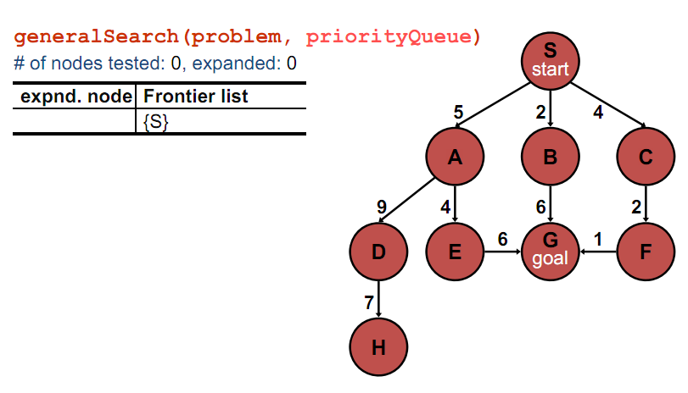
Uniform Cost Search (UCS)

Slide 6
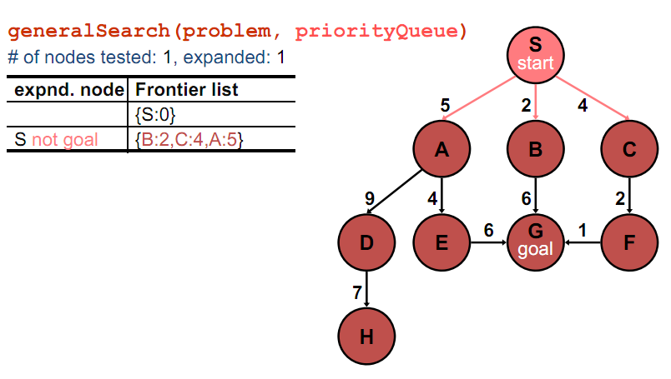
Uniform Cost Search (UCS)

Slide 7
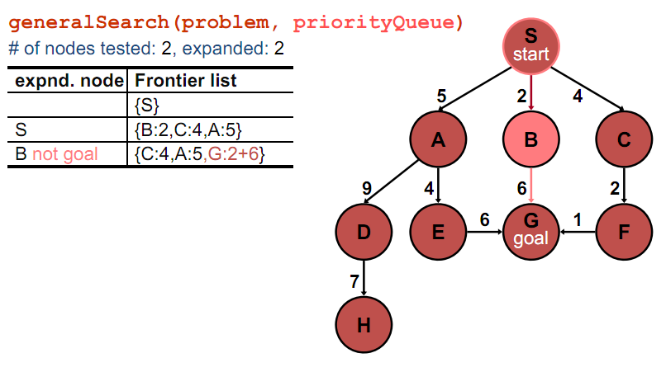
Uniform Cost Search (UCS)

Slide 8
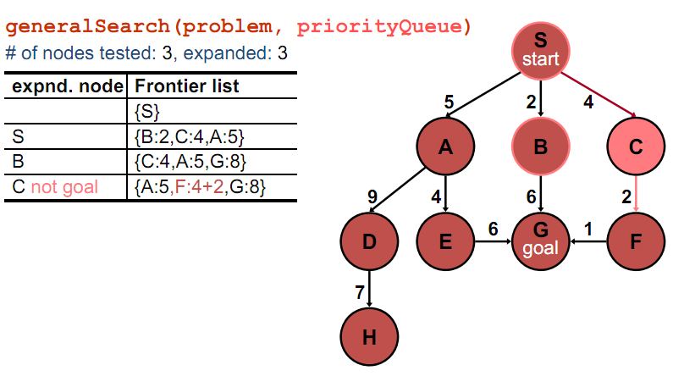
Uniform Cost Search (UCS)

Slide 9
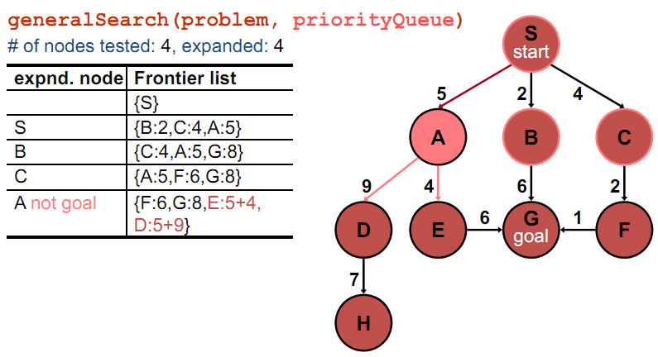
Uniform Cost Search (UCS)

Slide 10
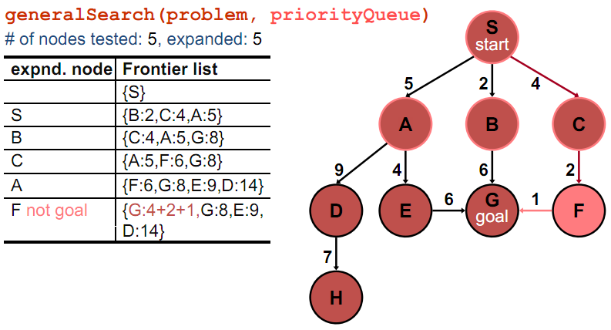
Uniform Cost Search (UCS)

Slide 11
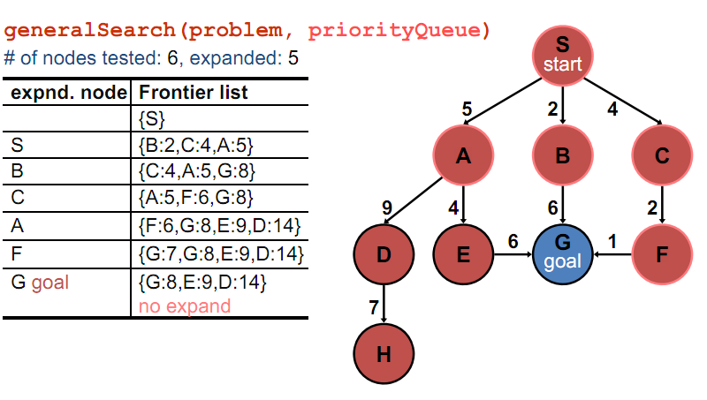
Uniform Cost Search (UCS)

Slide 12
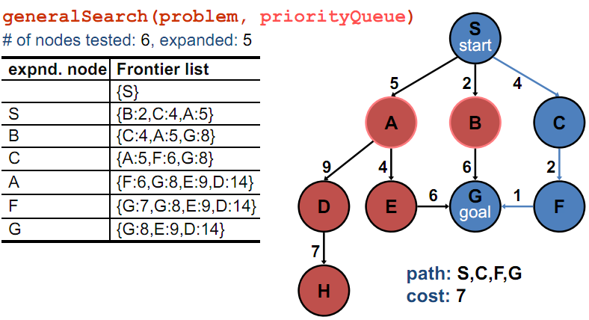
Uniform Cost Search (UCS)

Slide 13
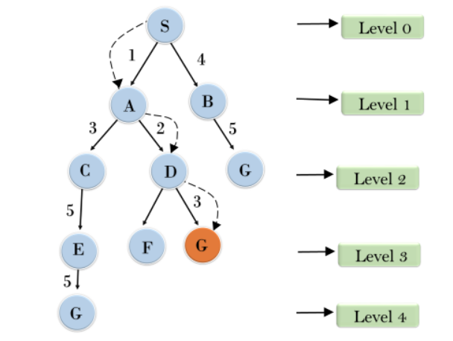
DIY

Slide 14
Solution
Path: G,D,A,S
Cost: 6

Slide 15
Properties
• Complete: Yes if arc costs > 0.
• Optimal: Yes
• Time and space complexity: O(b^d )
(i.e.,exponential)
– d is the depth of the solution
– b is the braching factor at each non‐leaf node
•Worst case time complexity is O(b^c/m )
Where c is the cost of an optimal solution and m is the minimum edge cost.

Slide 16
Assignment
Iterative deepening search
Depth limit search

